Slide 1
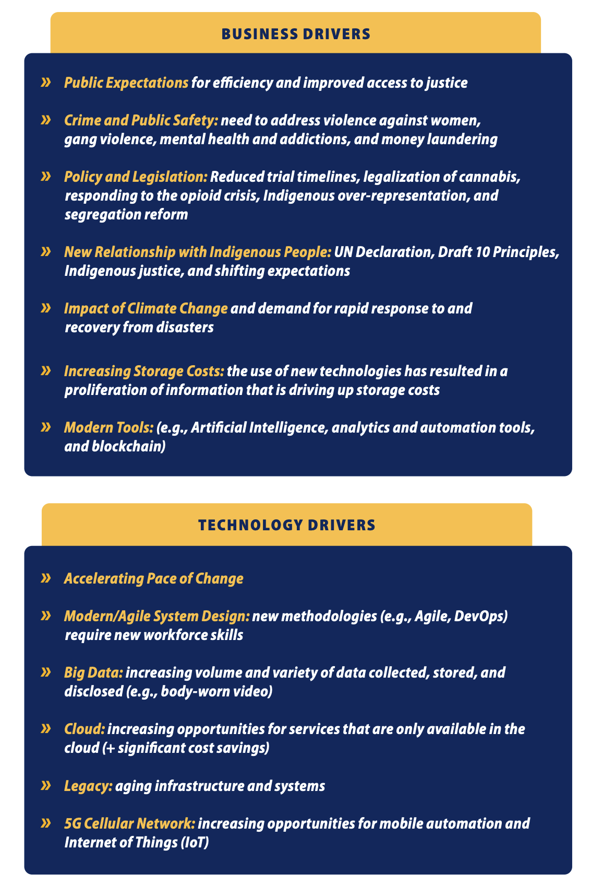
The Digital Imperative
Justice and Public Safety Sector Digital Strategy
The Justice and Public Safety Sector Digital Strategy aims to integrate data and technology capabilities to improve outcomes for British Columbians. The strategy focuses on three core areas:
fostering a culture of innovation,
establishing digital governance and processes,
developing digital capabilities and platforms.
The strategy aims to create seamless, smart, and continuously improved digital justice and public safety services that are accessible anytime, anywhere and on any device. The strategy addresses the challenges faced by the justice and public safety sector.

Slide 2
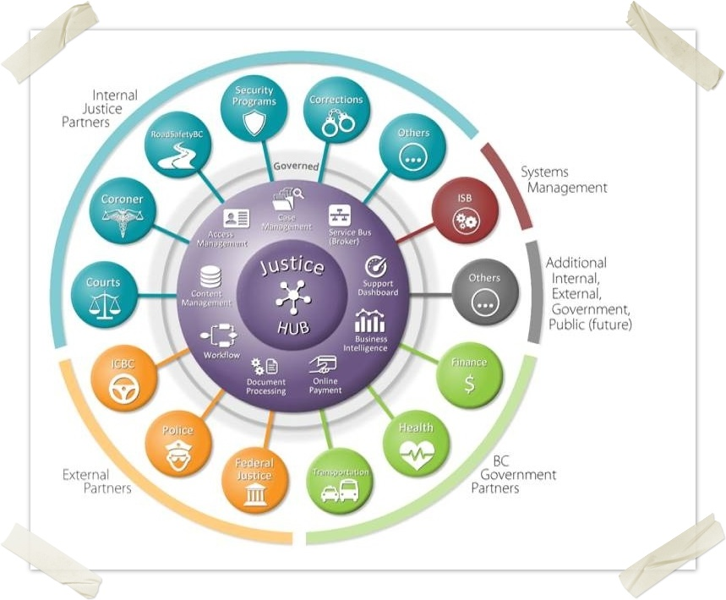
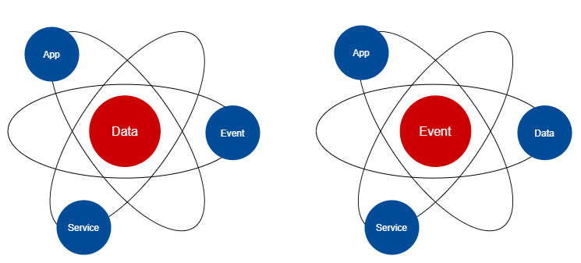
Scaling Vision – The Digital Business Nervous System
Concept: JADE – Justice and Public Safety Sector Agile Integrated Digital Ecosystem.
JADE as the sector’s event-based business integration platform.
Being event-driven is different for the sector:
Instead of focusing on data at rest, we focus on data in flight.
Instead of preserving data as the first priority, we focus on responding to events as the first priority.
Instead of data stores being the source of truth, we rely on the log of events as the source of truth.
Instead of IT as enterprise information repository, we see IT as the sector's digital business nervous system.
JADE

Slide 3
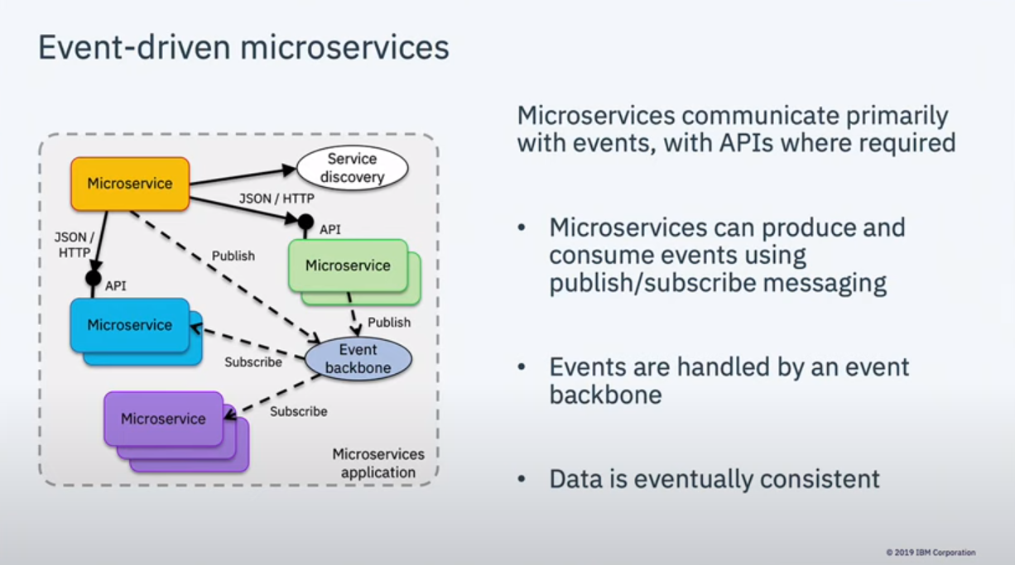
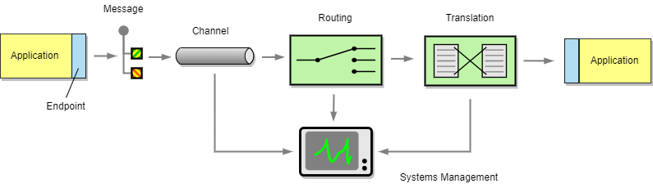
JADE Building Blocks
JADE is an ecosystem of business domain-specific integration services built on Enterprise Integration Patterns. A JADE integration service is composed of one or more of:
Event Topic – a time-based collection of business events related to specific business objects (e.g., a court case).
Adapter – a two-way smart system interface designed to connect an external system to a specific business domain in JADE.
Service – a business level API (aka “commands”) that decouples a business function from the underlying system or systems that implement it.
Processor – an independent event processing logic that can be developed and deployed independently. (learned improvement from current DEMS Integration work.)
In addition, JADE integration services are monitored and reported using Splunk.

Slide 4
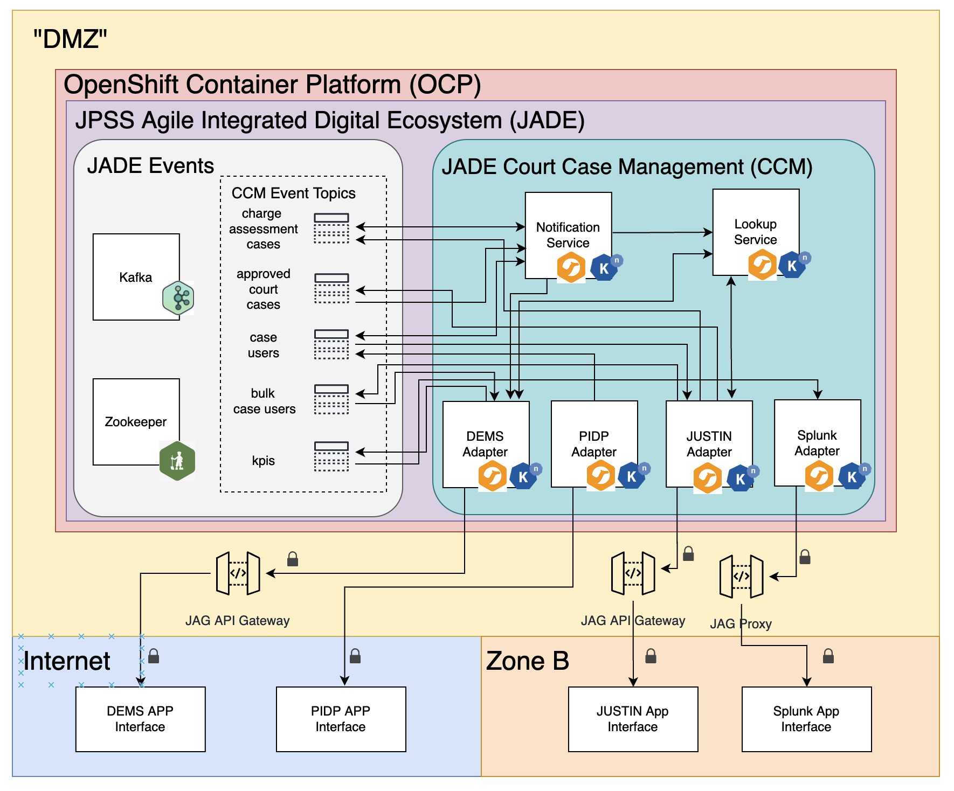
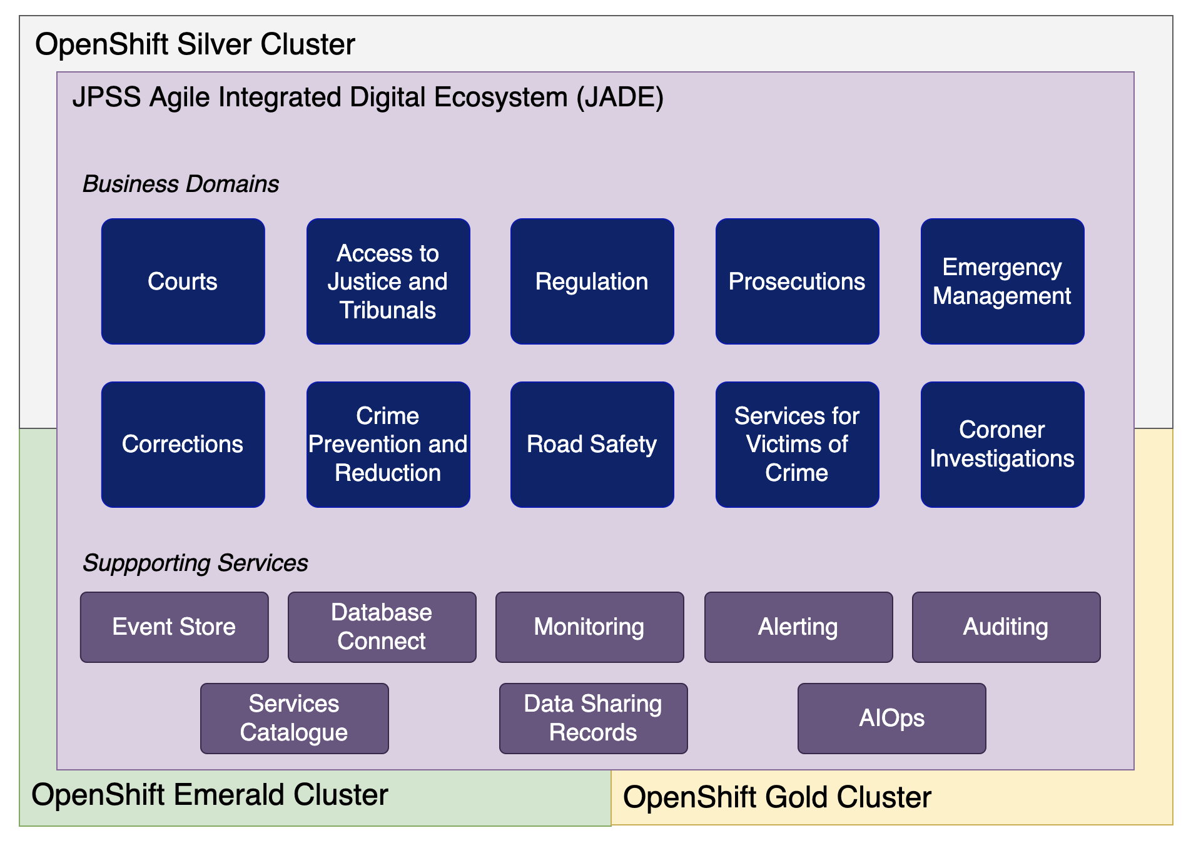
Scaled to Multiple Business Domains and Apps
JADE can be scaled to support the business domains and apps for the entire Justice and Public Safety sector with common infrastructure services such as event store, data connect functionality, monitoring, alerting and auditing. Additionally, business level shared services such as services catalogue, data sharing records, and automation can be built on JADE.

Slide 5
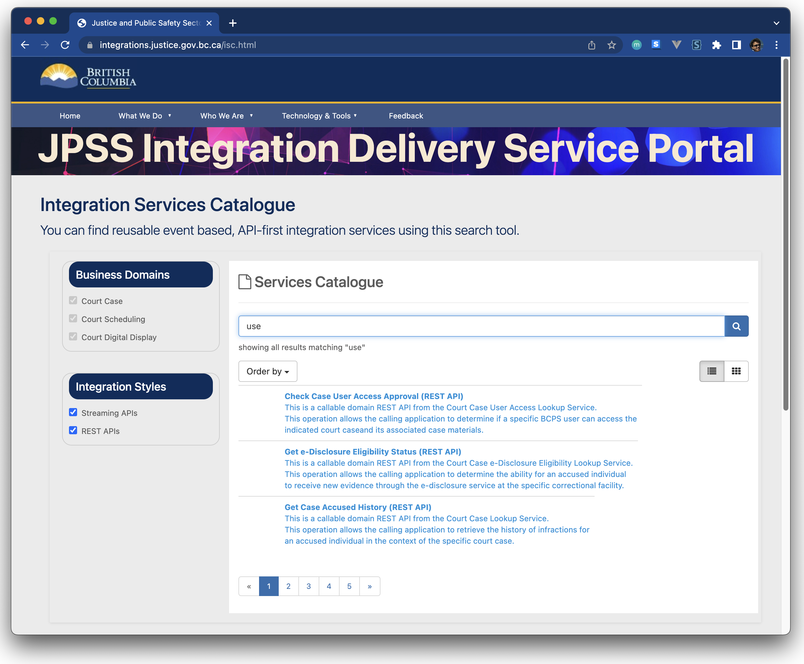
Integration Services Catalogue
Live concept demo site
https://integrations.justice.gov.bc.ca/isc.html
To make JADE accessible, we will stand up a business-focused integration services catalogue. The catalogue is:
A set of business domain-centered event and command (service) definitions. They are defined using each business domain’s common data model and sector business terminology.
A central registry of available and needed integration services.
A data store of data sharing records, stating the producers and consumers of a given business data or event. Executable data access policies can be generated from these data sharing records.

